Slide 1
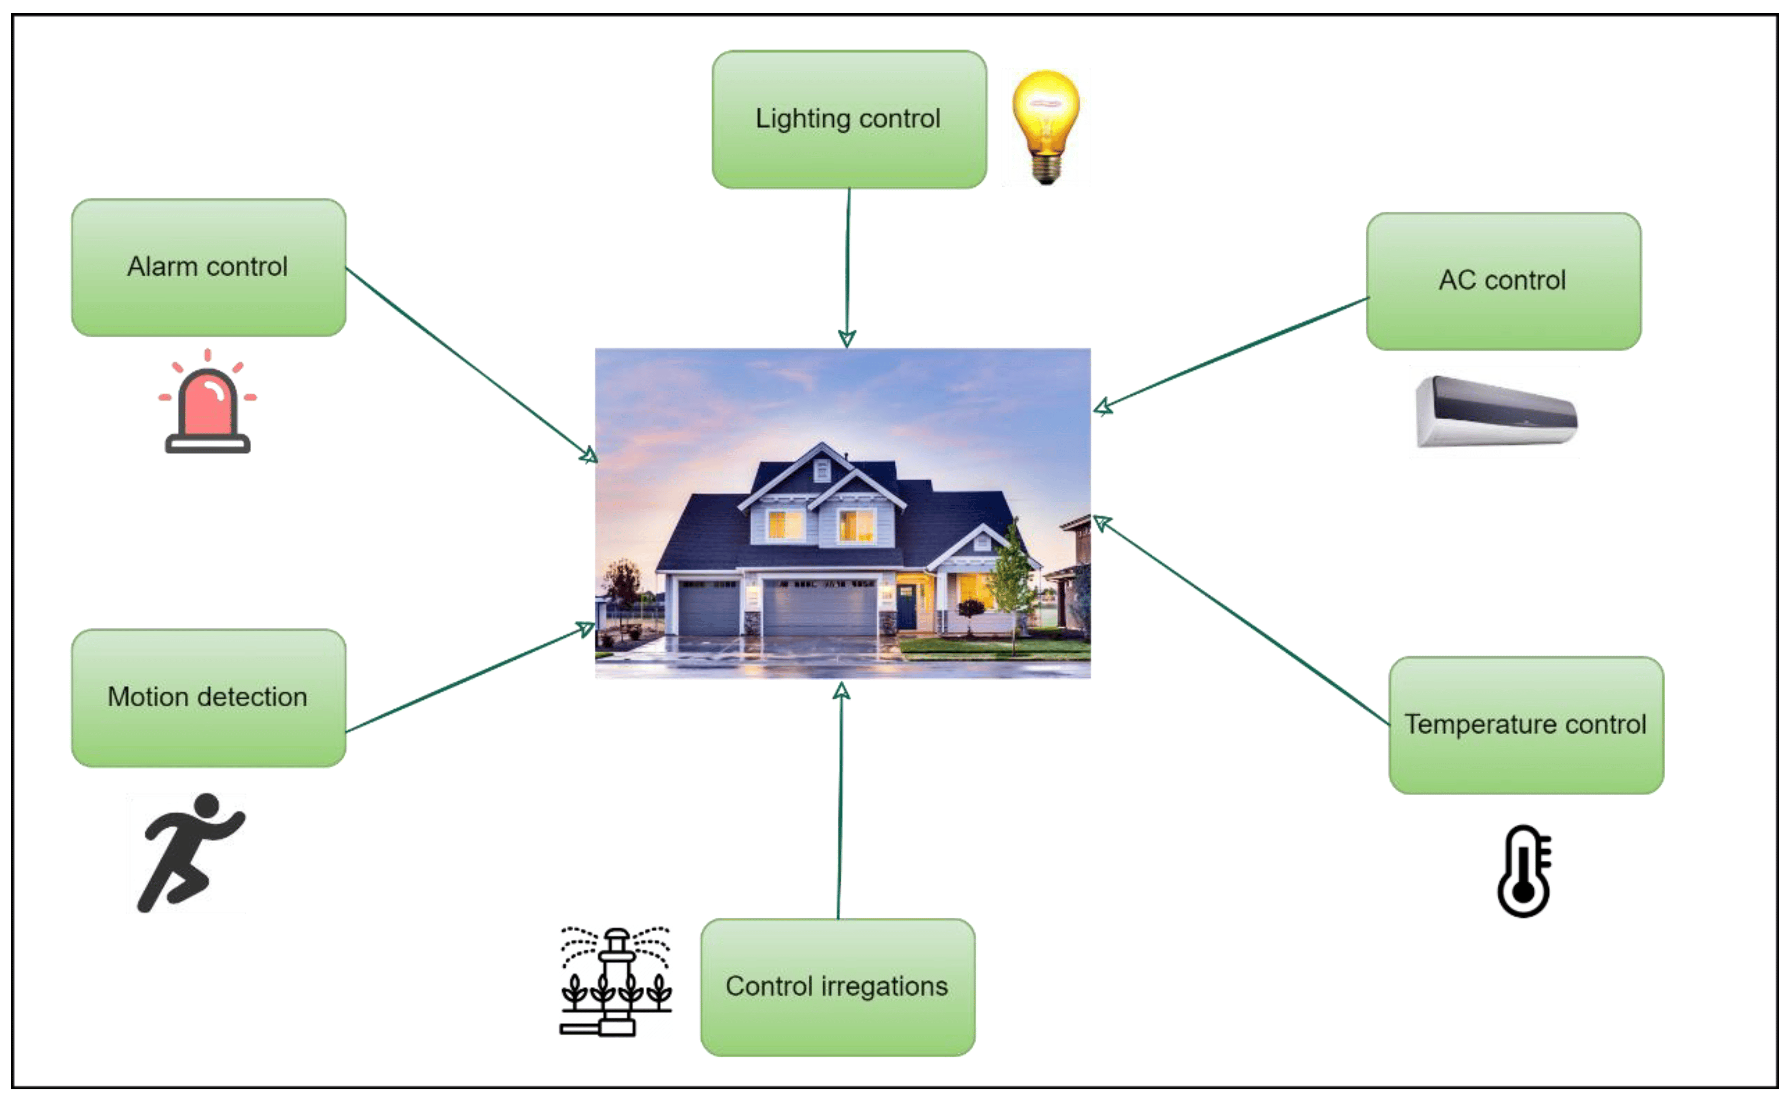
Lab Automation System

Slide 2
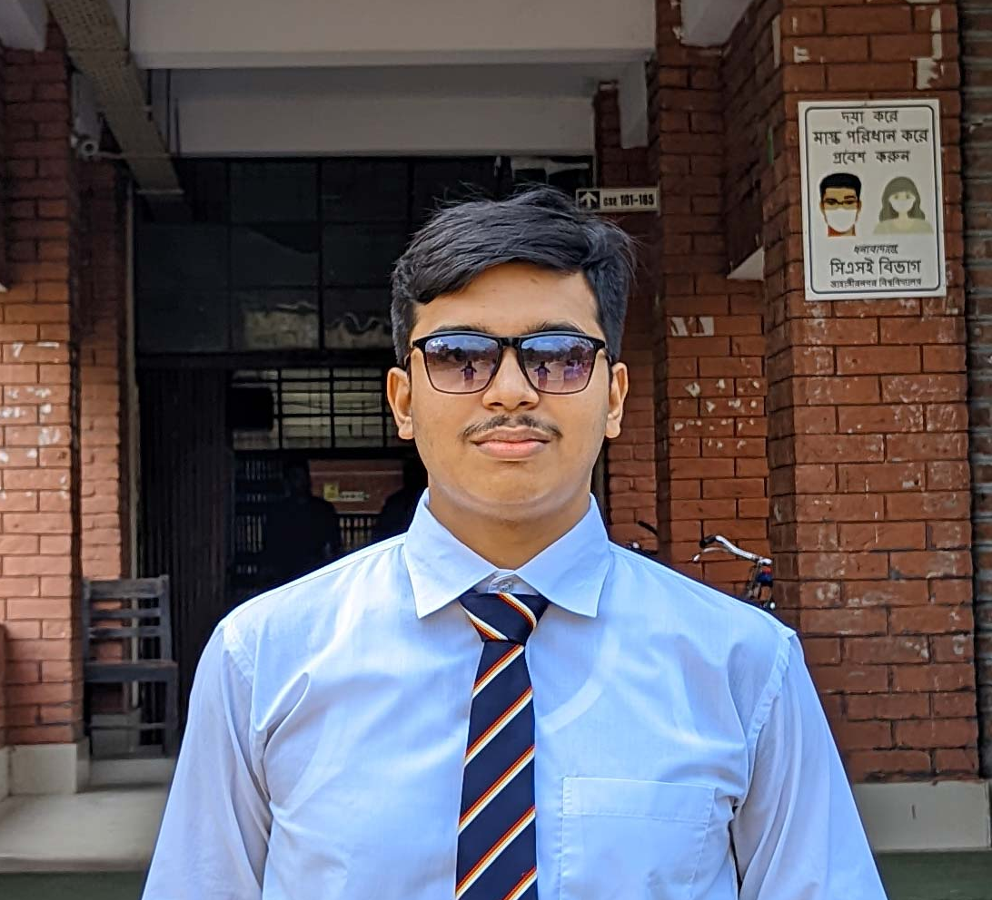

Team Members
Md. Mahebi Alom Dipu Sadia Anjum Opi

Slide 3
Project Overview
The project aims to design and implement a smart lab automation system using an ESP32 microcontroller. The system will allow users to control appliances through multiple input methods, including:
IoT platform (Blynk) for remote access and control.
IR remote for local wireless control.
Manual switches for direct physical interaction.
PIR sensor to automate the operation based on motion detection.
DHT 11 sensor to monitor temperature and humidity.
Relay for controlling AC load.

Slide 4
Major Components
ESP32 Dev Board -38 pin
4-Channel Relay
1.3 Inch Oled Display
PIR Sensor
TSOP1838 IR Receiver
IR Remote

Slide 5
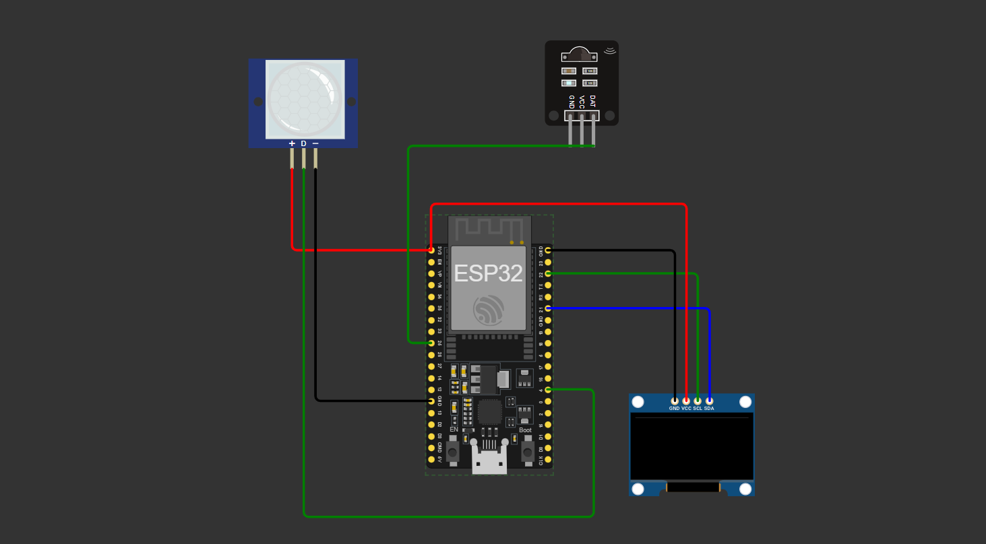
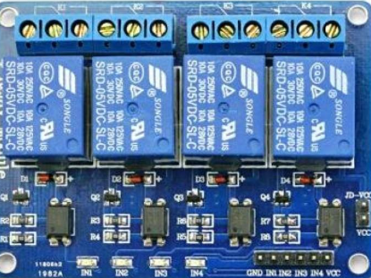
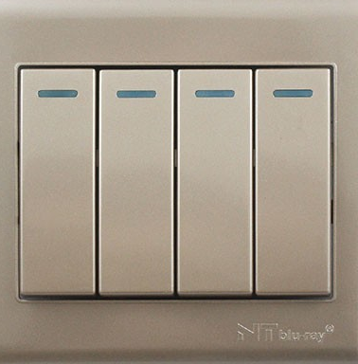


Circuit Diagram
IR Receiver
Pir Sensor
Relay Module
Switch
Display

Slide 6
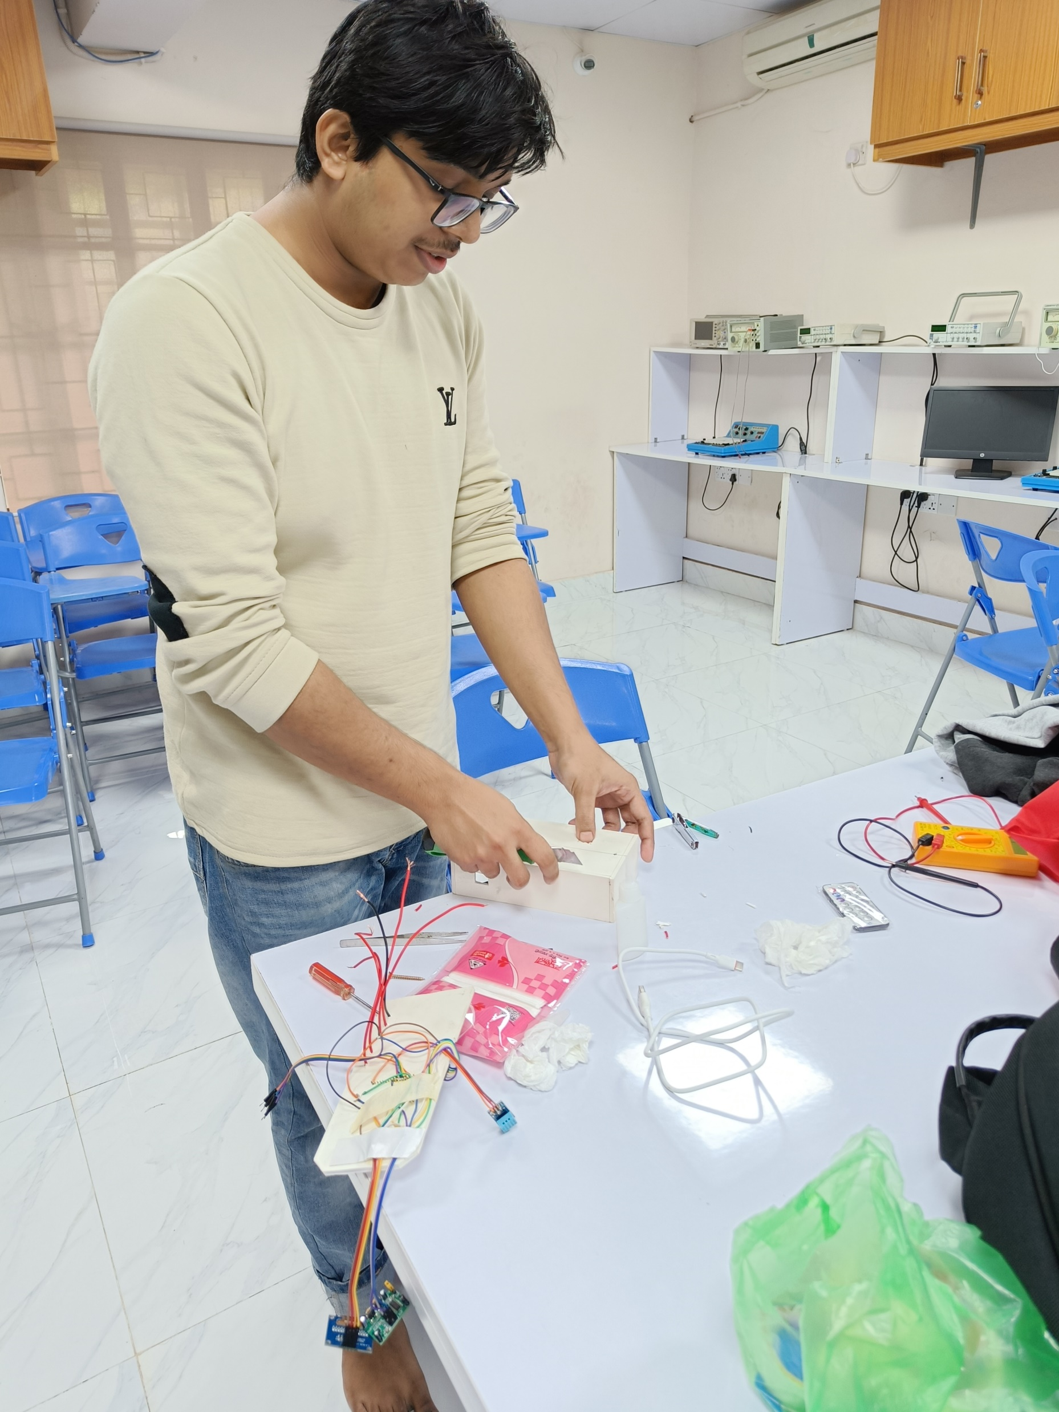
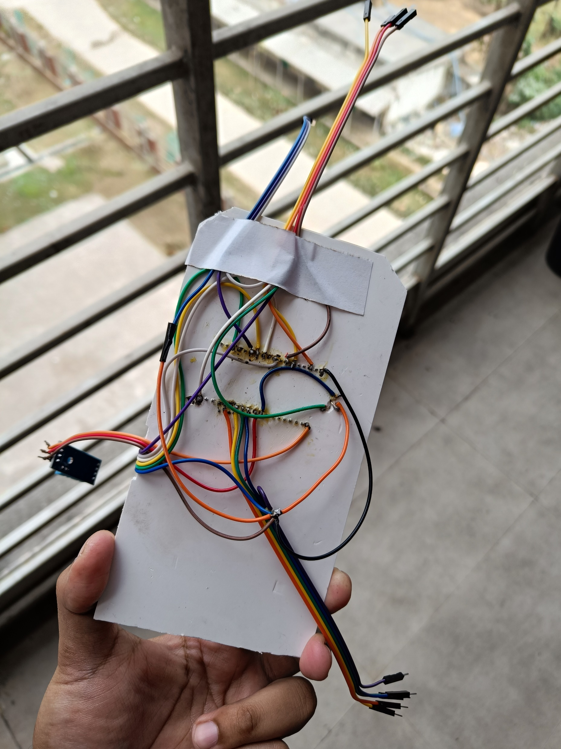
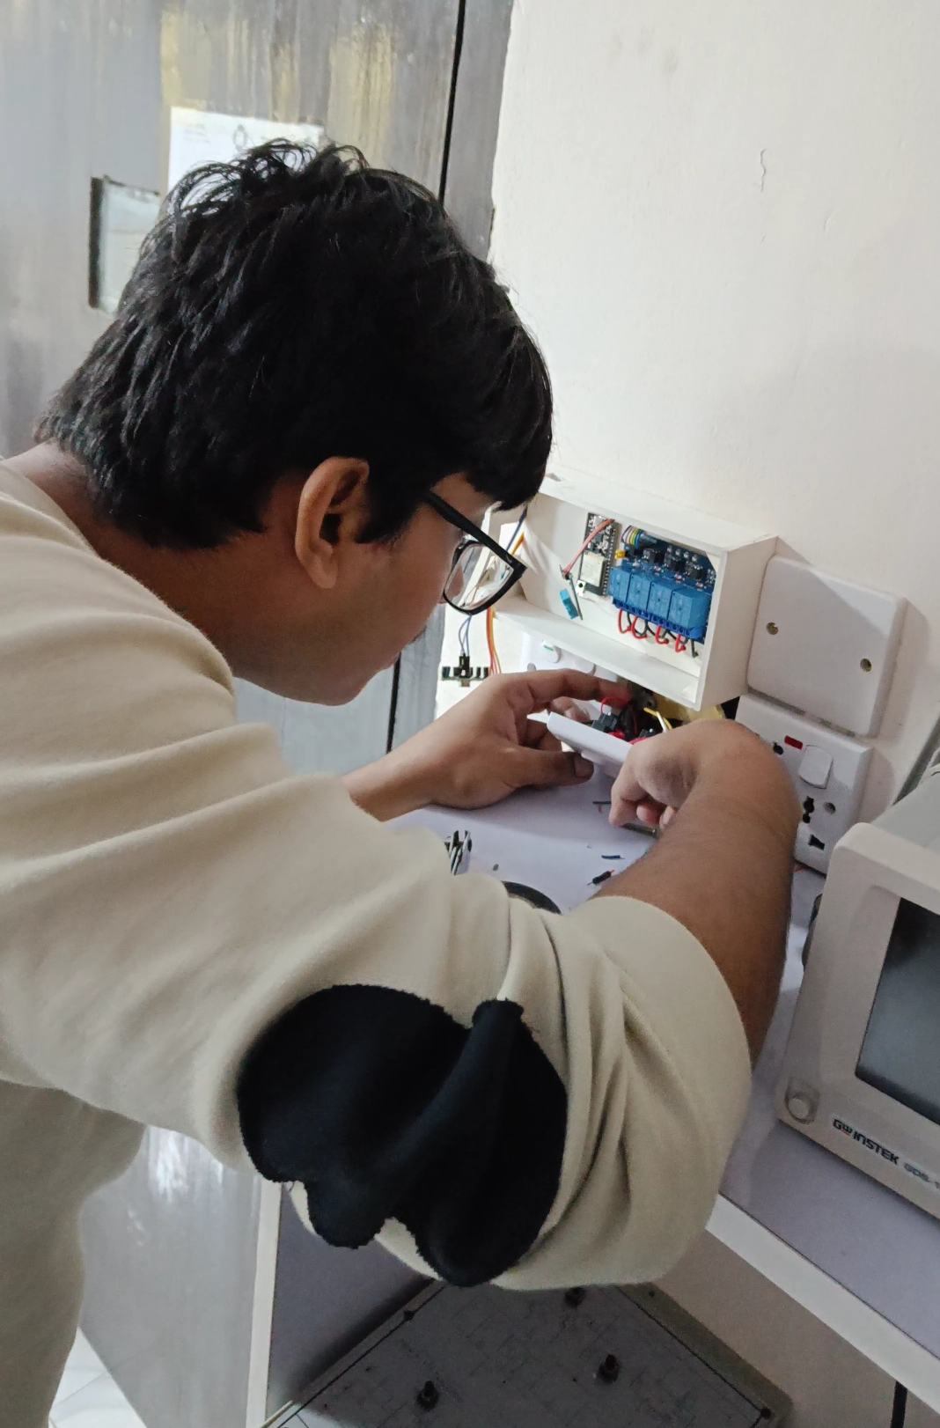
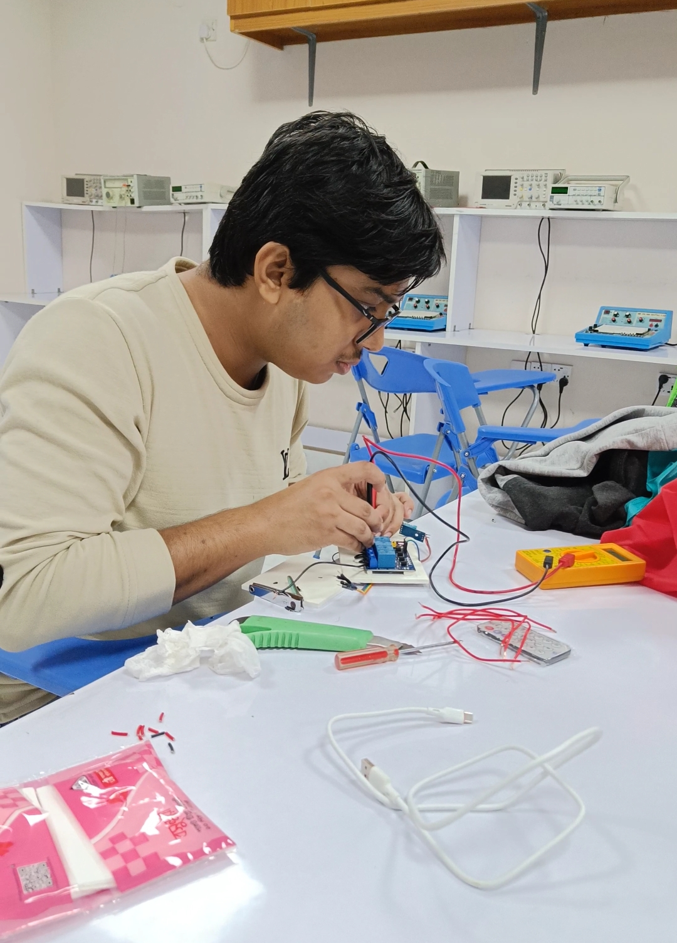
Working Snapshots

Slide 7
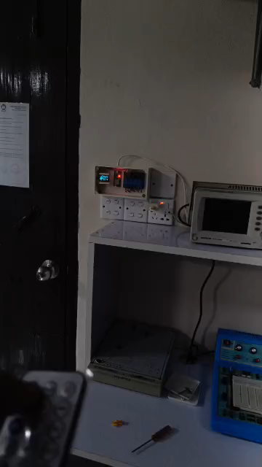
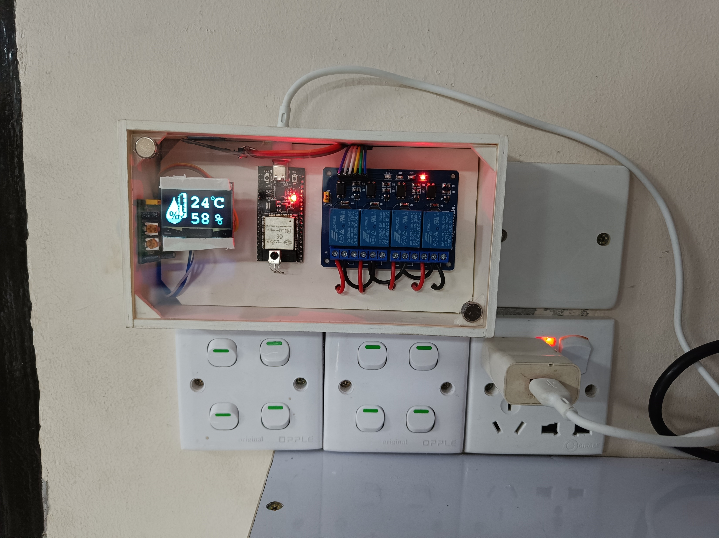
Working Snapshots

Slide 8
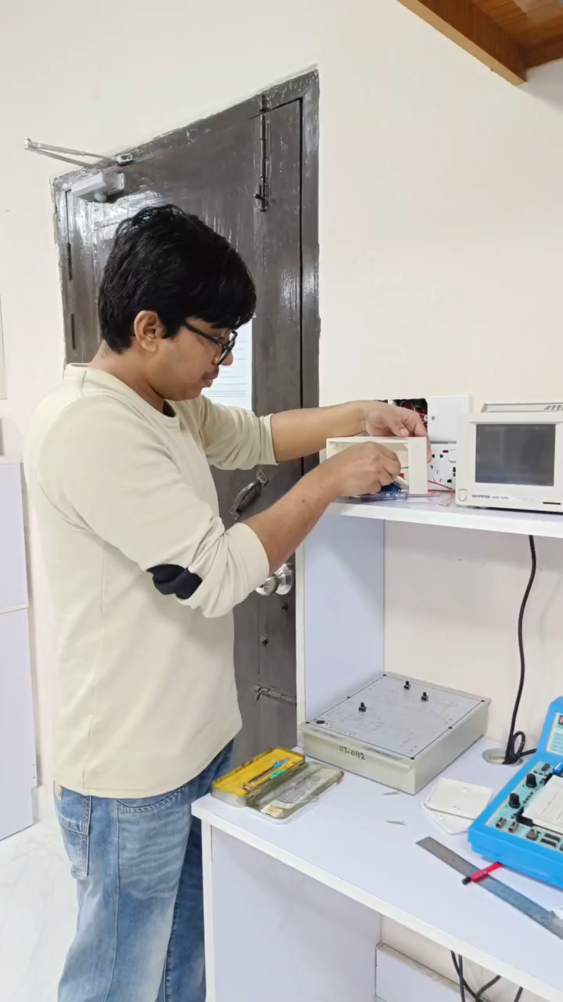
Working Snapshots

